Slide 1
My Digital Portfolio
STUDENT NAME: KAVYA P
REGISTER NO AND NMID: 0580C3300D11C34BD824570693004690
DEPARTMENT: B.SC COMPUTER SCIENCE
COLLEGE: COLLEGE/ UNIVERSITY
COLLEGE:ARCOT SRI MAHALAKSHMI WOMEN'S COLLEGE, VILAPAKKAM
UNIVERSITY:THIRUVALLUVAR UNIVERSITY

Slide 2
PROJECT TITLE
My Digital portfolio

Slide 3


AGENDA
Problem Statement
Project Overview
End Users
Tools and Technologies
Portfolio design and Layout
Features and Functionality
Results and Screenshots
Conclusion
Github Link
3/21/2024 Annual Review

Slide 4

PROBLEM STATEMENT
After completing my studies, I secured a good job that aligns with my skills and interests. However, standing out in today’s competitive job market requires more than just qualifications. Many talented individuals struggle to effectively present their skills, projects, and growth journey. This portfolio showcases my academic background, practical experience, and key accomplishments. It serves as a professional platform to highlight my strengths, dedication, and career journey.

Slide 5

PROJECT OVERVIEW
Project Title: My Digital Portfolio
Developer:Kavya – Computer Science Student
Objective: The main objective of this project is to create a personal digital portfolio website that showcases academic achievements, projects, certifications, and contact details. The portfolio serves as an online resume to present skills and accomplishments to recruiters, peers, and potential collaborators.

Slide 6
Description:
This portfolio website is designed with a clean and responsive layout. It highlights key sections such as:
About Me – Provides a brief introduction, career goals, and learning interests.
Projects – Displays the completed projects with descriptions (e.g., Portfolio Website as the first project).
Certificates – Lists academic and professional certifications with links to view them.
Contact – A simple contact form that allows visitors to reach out directly.
Features:
Responsive design for accessibility on different devices.
Easy navigation with menu links (About, Projects, Certificates, Contact).
Certificates section with clickable “View Certificate” links.
Contact form for user interaction.
Professional look with proper formatting and sections.

Slide 7

WHO ARE THE END USERS?
1. Recruiters and employers to check my skills and achievements.
2. College faculty to review my academic progress and certifications.
3. Mentors to guide me through my career path.
4.peers and classmates for collaboration and learning.
5.Professional networks to explore my portfolio.
6.General visitors who want to know about me.isgvim.
7.Anyone interested can contact me through the website.

Slide 8

TOOLS AND TECHNIQUES
Tools and Techniques:
HTML→ Used to structure the web pages (About, Projects, Certificates, Contact).
CSS→ Applied for styling, layout design, and creating a clean, professional look.
JavaScript (JS) → Added interactivity and smooth navigation between sections.
Codepen → Online platform used for coding, testing, and previewing the project in real time.
Responsive Design → Ensured that the portfolio works well on mobile and desktop devices.
Link Integration → Used hyperlinks to attach certificates and project details.

Slide 9
POTFOLIO DESIGN AND LAYOUT
The portfolio is designed with a simple and user-friendly layout. The homepage includes the project title, my name, and navigation links (About, Projects, Certificates, Contact) at the top for easy access. The About Me section provides a short introduction about my goals and interests. The Projects section highlights my first project, while the Certificates section lists my achievements with clickable links to view them. Finally, the Contact section makes it easier for visitors to connect with me. A combination of blue and white colors is used for a clean and professional look, and the design is responsive so it can be viewed on both mobile and desktop devices.
9

Slide 10
FEATURES AND FUNCTIONALITY
1.Navigation Bar – Provides quick access to different sections (About, Projects, Certificates, Contact).
2.About Me Section – Displays personal introduction, career goals, and skills.
3.Projects Section – Showcases completed projects with descriptions. 4. Certificates Section – Lists achievements with links to view/download certificates.
5.Contact Section – Allows visitors to connect easily.
6.Responsive Design – Works smoothly on mobile, tablet, and desktop screens.
7.Clean Layout & Styling – Blue and white theme for a professional look.
8.Interactive Links – Certificates and projects are clickable for detailed view.

Slide 11

RESULTS AND SCREENSHOTS
✅ Sections in Your Portfolio
1.Header-Displays your name, title (Computer Science Student), and profile photo.
2.Navigation Bar – Links to different sections: About, Projects, Certificates, Contact.
3.About Me – Short introduction about your goals, skills, and learning journey.
4.Projects – Your first project (Portfolio Website).
5.Certificates – A list of certificates with "View Certificate" links.
6.Contact Form – Visitors can fill their name, email, and message.
3/21/2024 Annual Review
11

Slide 12
7. Footer – Copyright with social media links.
Design Highlights:
Head header with white text (professional look).
Profile photo in the center (can be customized).
Clean layout with good spacing and alignment.
Contact form styled with hover effects.
Social media links in footer for networking.
Functionality:
Navigation scrolls to each section.
Contact form shows a success message (via JavaScript).
Certificates can be linked to actual documents.
👉 Overall, the result is a professional portfolio website where you can showcase your skills, projects, and certificates to teachers, recruiters.

Slide 13
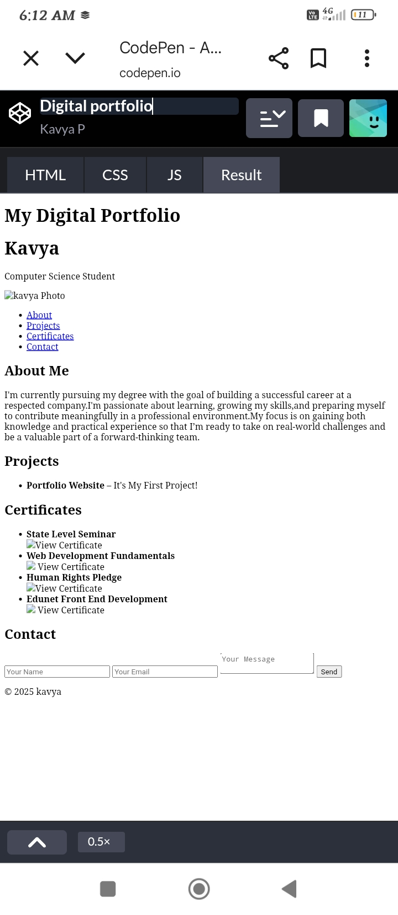
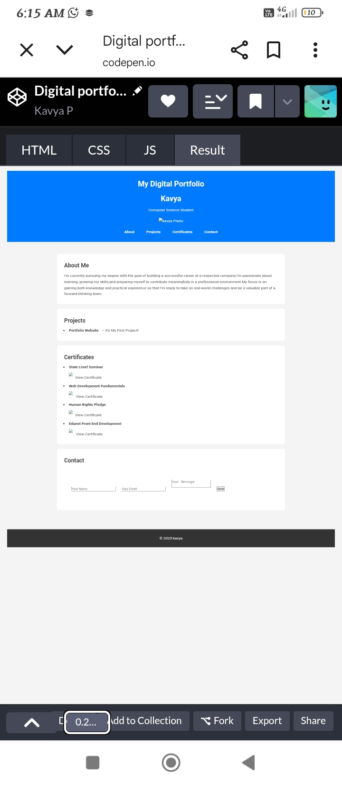

Slide 14
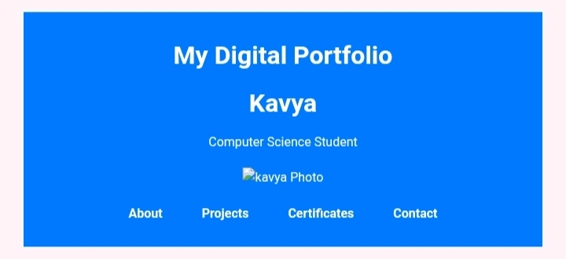
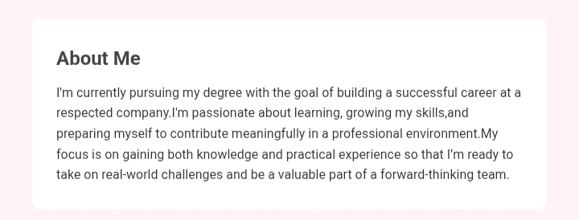

Slide 15
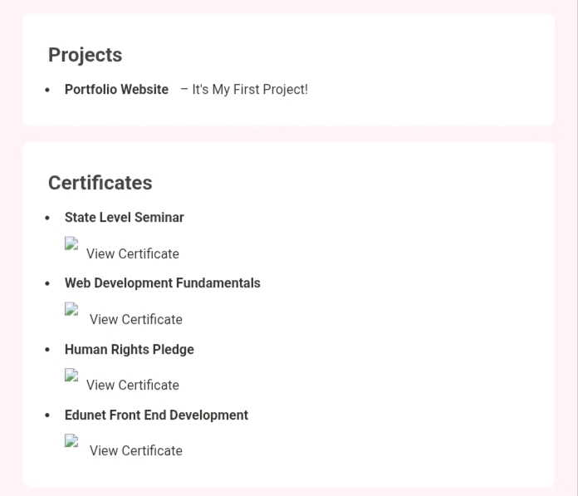

Slide 16
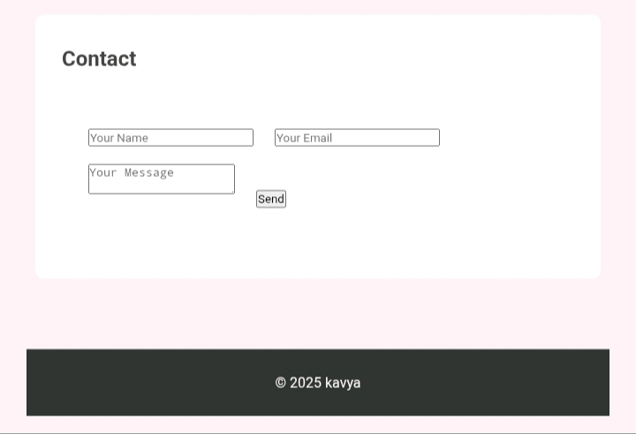

Slide 17
CONCLUSION
This project helped me design and develop my own digital portfolio, which showcases my personal details, projects, certificates, and contact information in a structured way. Through this, I gained practical knowledge of HTML, CSS, and JavaScript, and improved my skills in web design and front-end development.
The Portfolio is simple, user-friendly, and professional, making it easier for me to present my achievements and skills to teachers, recruiters, or companies. It also gave me confidence in creating real-world web applications.
Overall, this project enhanced both my technical knowledge and my ability to express myself digitally, and it serves as a strong foundation for future projects in web development.
17

Slide 18
9.GitHub Link
https://github.com/kavyap222007/TNSDC-FWD-DP1.git

